Slide 1
Stock Market Prediction
By:
Vibhu Agarwal
Karuna Mangla
Aman Singh

Slide 2
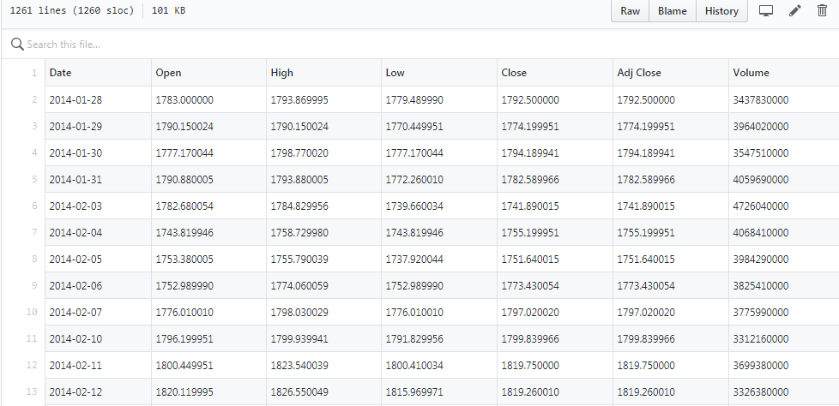
Data Set

Slide 3
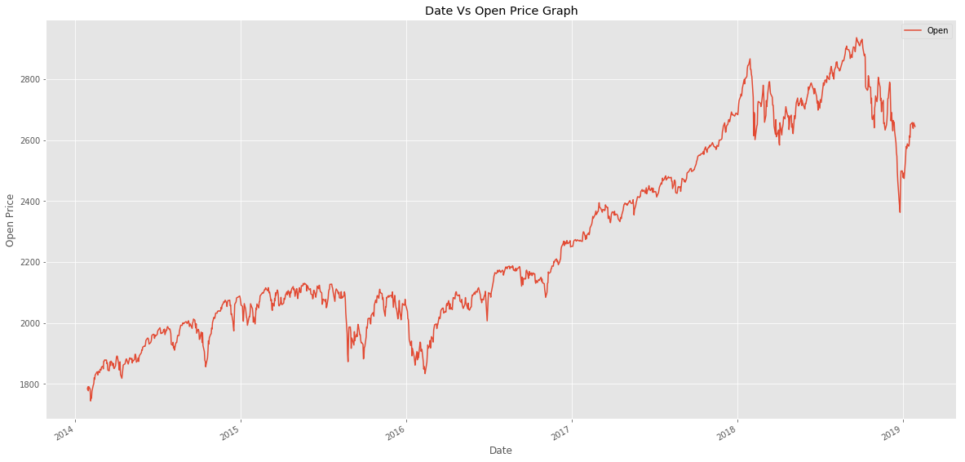
Original Graph

Slide 4
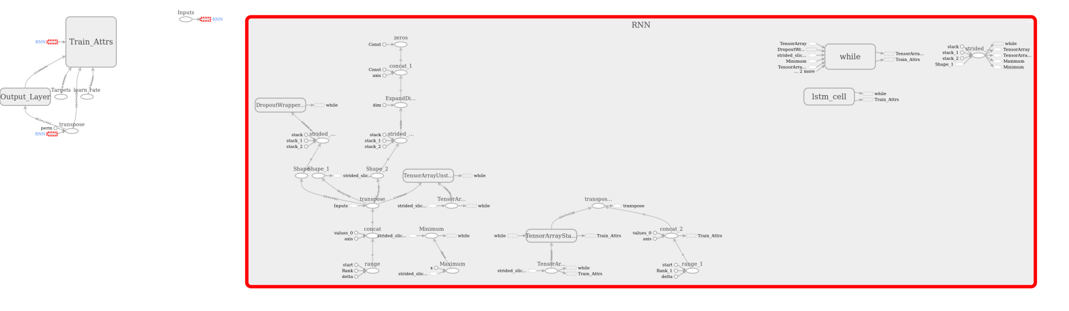
Recurrent Neural Networks

Slide 5
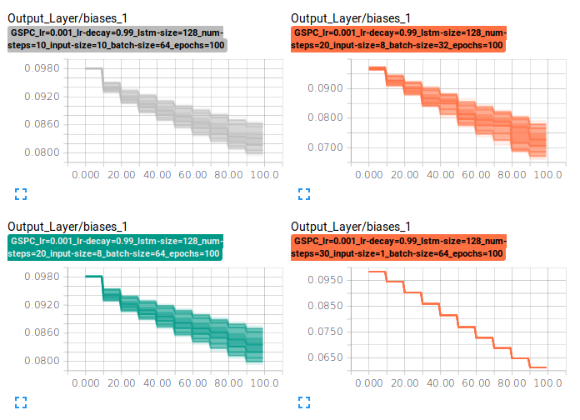
Output layer Biases

Slide 6
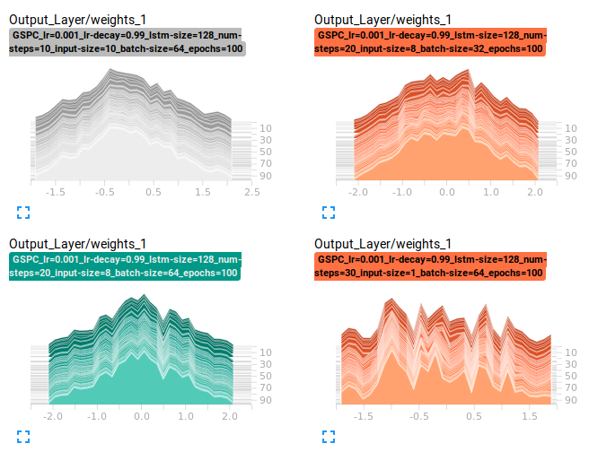
Output layer Weights

Slide 7
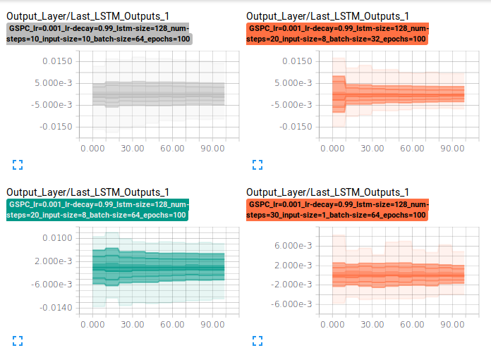
LSTM Output Layer values

Slide 8
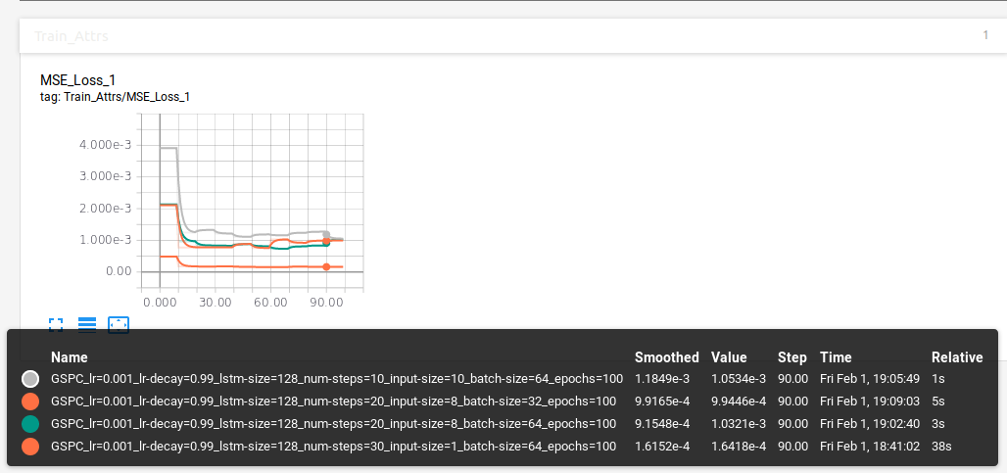
LSM Loss

Slide 9
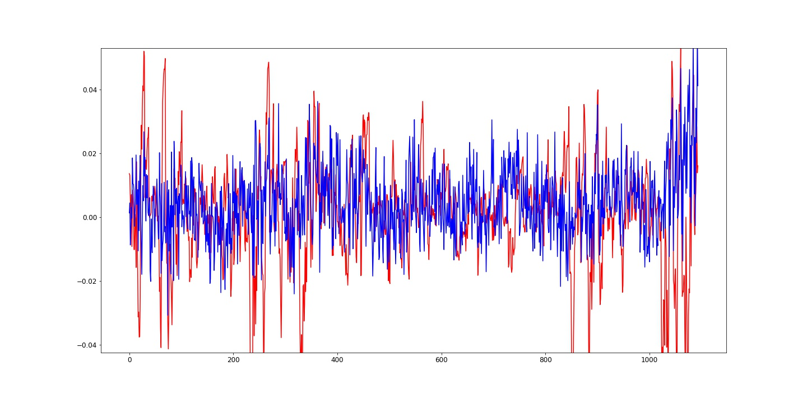
GSPC_lr=0.001_lr-decay=0.99_lstm-size=128_num-steps=20_input-size=8_batch-size=32_epochs=100

Slide 10
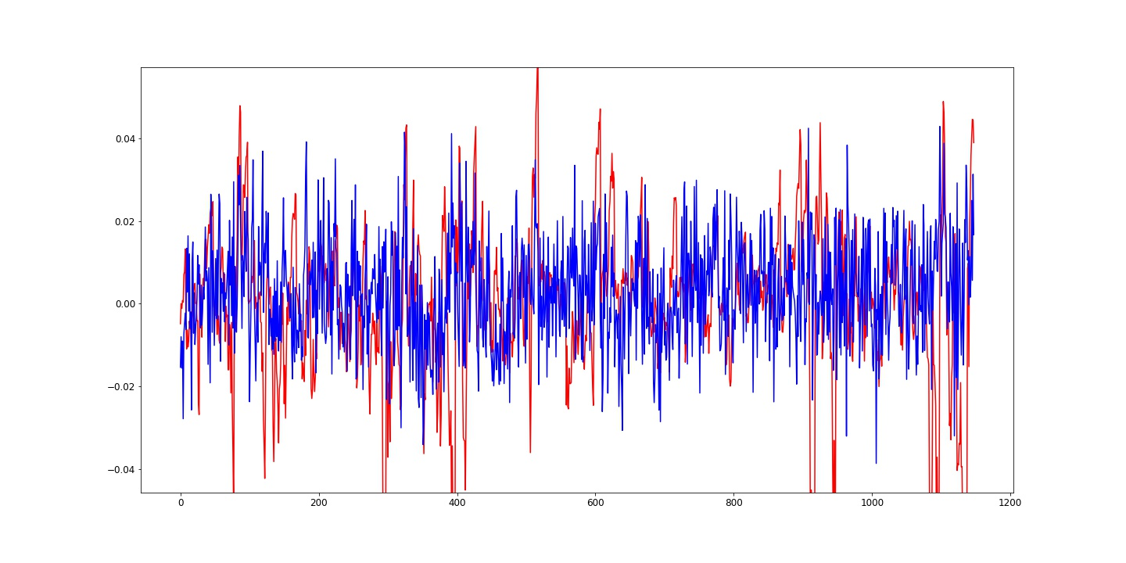
GSPC_lr=0.001_lr-decay=0.99_lstm-size=128_num-steps=10_input-size=10_batch-size=64_epochs=100

Slide 11
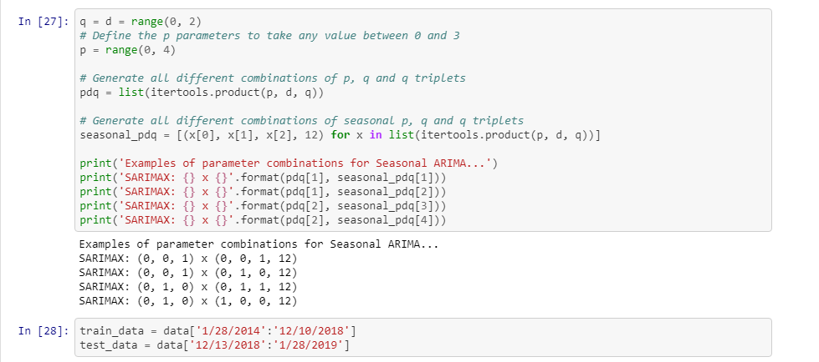
ARIMA parameters

Slide 12
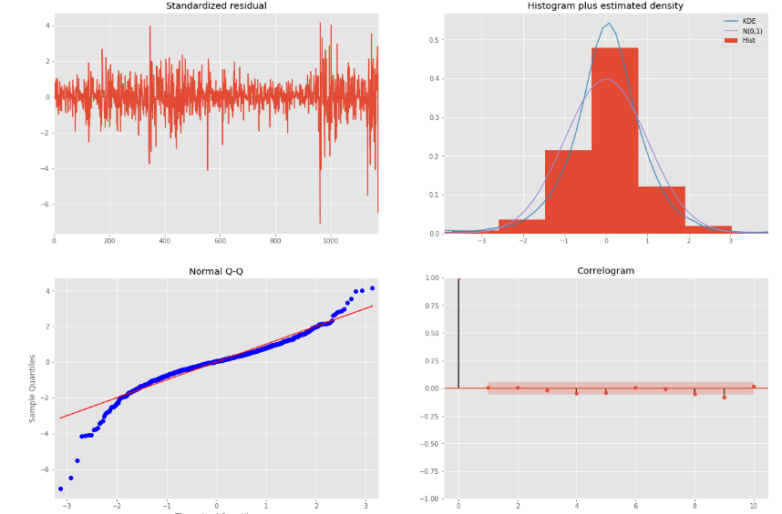
Fitting the model

Slide 13
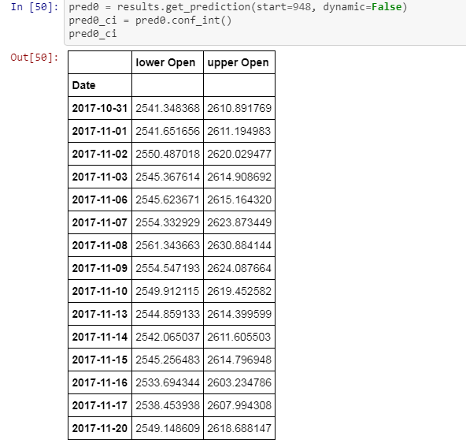

Slide 14
